Slide 1
Technical Bootcamp
Week 5
Akshita Verma
Associate Data Engineer

Slide 2
Python
Python is a dynamic, high-level, free open source, and interpreted programming language. It supports object-oriented programming as well as procedural-oriented programming.
Open source
Easy to code
Object oriented language
Dynamically typed
Interpreted Language
Data types
Lists
Dictionary
Tuple
Array
Set

Slide 3
Pyspark
Pyspark is an analytics tool. It is a python-based API used for the Spark implementation and is written in Scala programming language.
Features:
It is immutable.
Low latency
It is fault tolerant.
It supports Spark, Yarn, and Mesos cluster managers.
Lazy Evaluation
It is dynamic in nature.
Polygot- Supports multiple languages (R, C#, Python, Scala, SQL)

Slide 4
Concepts in Pyspark
RDD(Resilient Distributed Dataset)
-Building block of spark
-list of data(not structured)
-Data frame, abstraction layer on top of RDD
Transformations
Text_file_rdd=dc.textFile(path)
Flatmap: Line is split into words
Map: word,1
reduceByKey: (word,count)
Caching
Persistent,unpersistant

Slide 5
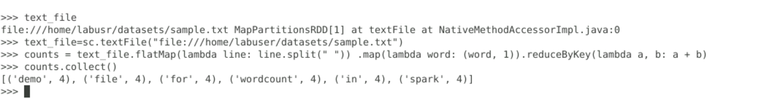
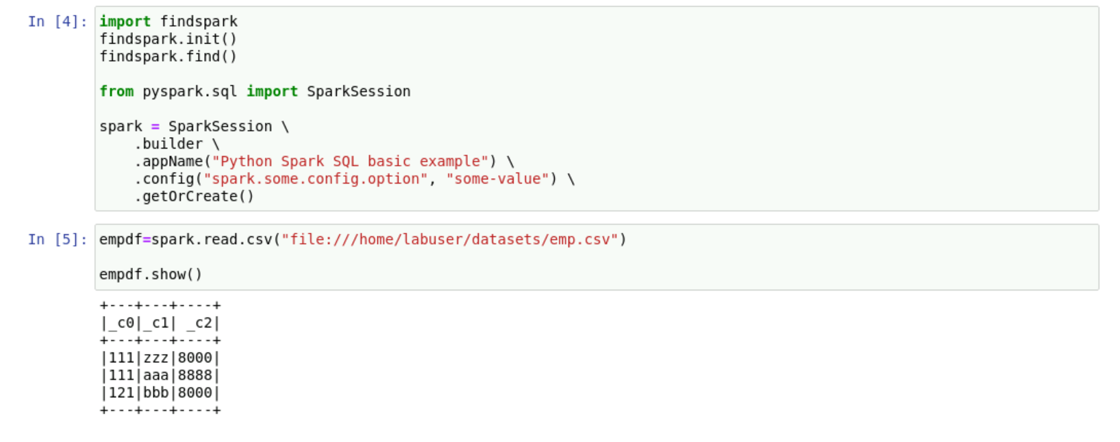
Pyspark hands on

